Slide 1

Enhancing Property Price Prediction Using Natural Language Processing
Presented By: - Suman Attri(1055553)
& Aisha Mohammad( 1037405)
May 13th , 2025

Slide 2
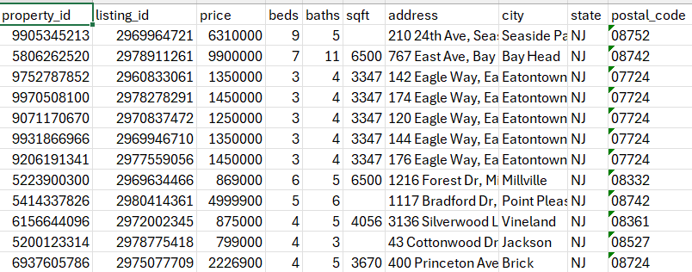
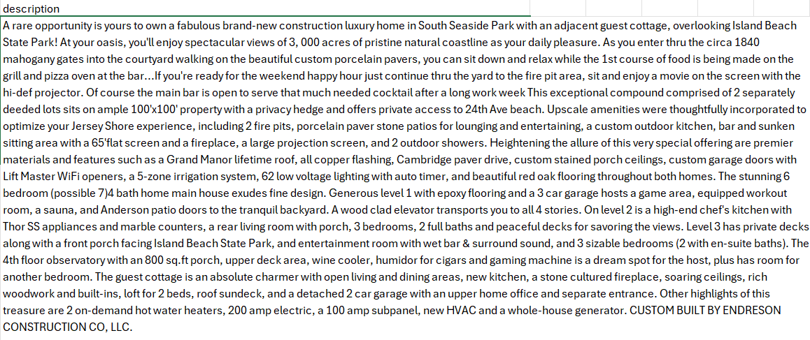
PROBLEM OVERVIEW
Traditional models rely only on structured data.
Overlooked Opportunity: Listing descriptions contain rich, price-relevant qualitative details.

Slide 3
Research Gap
Traditional house price models rely on structured data (e.g., size, location, year built), often ignoring valuable insights in property descriptions.
Text reveals key qualitative factors like condition & renovation, Amenities & design features, Neighborhood appeal.
While NLP excels in domains like sentiment analysis and market trends, its use in real estate pricing is still emerging (Zhang, 2023).
Leveraging property descriptions presents a clear opportunity to boost prediction accuracy.

Slide 4
Objectives
Build
Build an NLP pipeline to analyze rich property descriptions.
Extract
Extract qualitative features (e.g., amenities, condition, neighborhood cues) using:
Named Entity Recognition (NER)
Evaluate
Evaluate model performance by comparing:
Baseline models using only structured data
Enhanced models incorporating NLP-derived insights
Sentiment analysis

Slide 5
DATA PIPELINE
1. Data Collection
2. Preprocessing
3. Feature Engineering
4. Modeling
5. Evaluation

Slide 6
NLP Techniques - API
Used the US Realtor API (RapidAPI) to fetch structured and unstructured real estate data.
Implemented paginated retrieval with limit and offset to gather up to 10,000+ listings.
fetch_propert_list retrieves bulk listing metadata (price, beds, baths, address).
fetch_property_details enriches each listing with full property descriptions.
Used delays( time.sleep) to respect API limits and prevent overloading.
Combined structured and unstructured data and saved to CSV format for downstream analysis and modeling.

Slide 7
Structured Data Pre-Processing
Checked for missing values and dropped 122 entries that had missing descriptions.
Filled numeric columns beds, baths, and sqft using median and city using mode.
Normalized numerical features- price, Beds, baths, and sqft using MinMaxScaler.
Encoded categorical features- city, state, postal code using LabelEncoder.

Slide 8
NLP Techniques - Cleaning
Converted descriptions to lowercase for uniformity.
Removed punctuation and special characters.
Applied nltk.word_tokenize() for word level tokenization.
Removed common English stopwords to reduce noise.
Used Part-of-the-speech (POS) tagging to guide Lemmatization via WordNet (context-aware reduction to root forms).
Cleaned and processed property descriptions stored in a new column: description_clean

Slide 9
NLP Techniques – TF-IDF Vectorization
Transformed cleaned descriptions into numerical vectors using TfidfVectorizer
Limited to top 1,000 words to capture high-value features while reducing dimensionality
Converted TF-IDF sparse matrix into a pandas DataFrame for analysis and modeling
Computed global TF-IDF scores to identify the most influential terms in descriptions
Scanned feature set for unwanted characters (e.g., @, %, !, &)
Flagged and prepared to exclude noisy or irrelevant tokens

Slide 10
NLP Techniques – NER
Used spaCy's pre-trained model (en_core_web_sm) to identify meaningful entities from property descriptions.
Focused on relevant entity types: FAC (Facilities), ORG (Organizations), GPE (Geopolitical Entities), LOC (Locations)
Filtered out noisy entities using regex to keep only clean alphanumeric names- Removing short or malformed entries for quality control.
Applied MultiLabelBinarizer to convert named entities into binary features, enabling machine learning models to use this textual insight.

Slide 11
NLP Techniques - Sentiment Analysis (VADER)
Employed VADER from NLTK to assess property descriptions for emotional tone, luxury cues, and urgency.
Computed compound sentiment scores (–1 to +1) and classified them as:
Positive (> 0.05): 9,816
Neutral (–0.05 to 0.05): 26
Negative (< –0.05): 36
Ultimately, sentiment features were excluded from the final models due to significant bias.

Slide 12
Modeling Strategy
Model No. | Model Type | Text Features Used | Structured Data Used | Description
1 | Random Forest Regressor | None | Yes | Baseline model using only numerical/structured data
2 | Random Forest Regressor | TF-IDF + NER | Yes | Enhances baseline with extracted textual features
3 | XGBoost Regressor | TF-IDF + NER | Yes | Uses boosted trees to better handle text-structured mix
4 | Keras Neural Network (DistilBERT-based) | DistilBERT Embeddings | Yes | Deep learning model integrating raw text + features

Slide 13
RESULTS

Slide 14
Key Insights
NLP features improved price prediction accuracy by 16%.
XGBoost outperformed Random Forest by 6%, benefiting from better handling of sparse data and sequential error correction.
The Keras model (DistilBERT + structured data) underperformed with R² = 0.31, likely due to limited data (10K samples) and the model's need for larger datasets to generalize effectively.

Slide 15
Buisness Impact
More Accurate Pricing
Leverages hidden insights from property descriptions to improve valuation precision.
Smarter Listings Intelligence
Detects qualitative features like "renovated kitchen", "ocean view", or "luxury finishings" often missed by numerical models.
Faster and Informed Decisions
Helps buyers, sellers, and agents make quicker, data-backed pricing decisions.
Anomaly & Fraud Detection
Identifies listings with suspicious pricing through sentiment or keyword inconsistency.
Localized Market Understanding
Captures regional nuances (e.g., "near subway", "family-friendly neighborhood") to improve price targeting.

Slide 16
Future works
Adding external data: school ratings, crime stats, transit access
Using property images: apply computer vision to capture visual quality
Dataset expansion: cover multiple regions & property types

Slide 17

THANK YOU

Slide 18

Q&A

